Slide 1
Backtracking
Hamiltonian Circuits
Graph Coloring

Slide 2
Backtracking
Backtracking is an algorithm for capturing some or all solutions to given computational issues, especially for constraint satisfaction issues.
The algorithm can only be used for problems which can accept the concept of a “partial candidate solution” and allows a quick test to see if the candidate solution can be a complete solution.
Backtracking is a general algorithm for finding all (or some) solutions to some computational problems, that incrementally builds candidates to the solutions, and abandons each partial candidate (“backtracks”) as soon as it determines that the candidate cannot possibly be completed to a valid solution.

Slide 3
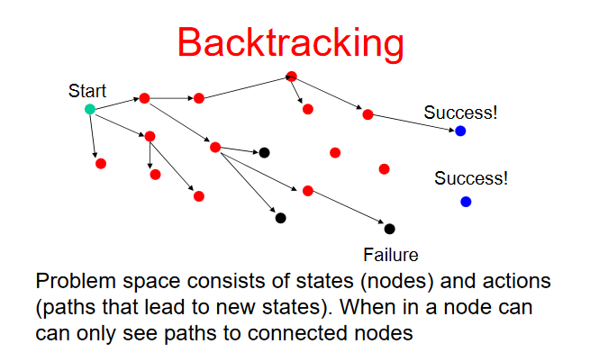
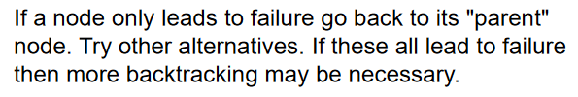
How it works?

Slide 4
Applications
Backtracking is considered an important technique to solve constraint satisfaction issues and puzzles.
It is also considered a great technique for parsing and also forms the basis of many logic programming languages.

Slide 5

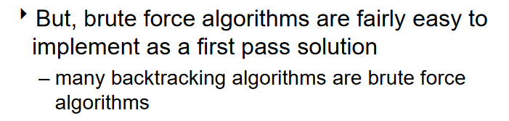
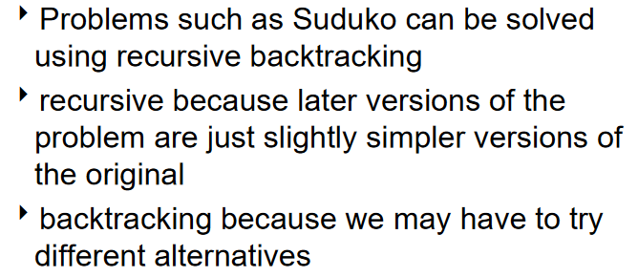
Brute force Vs Backtrack

Slide 6
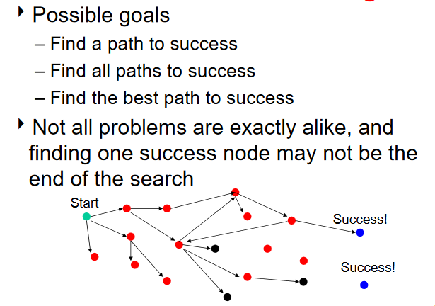
Goals of Backtracking

Slide 7
Hamiltonian Circuits Problem
A Hamiltonian circuit or tour of a graph is a path that starts at a given vertex, visits each vertex in the graph exactly once, and ends at the starting vertex. Some graphs do not contain Hamiltonian circuits.
v₁
v₂
v₃
v₁
v₂
v₃
v₄
v₅
v₆
v₄
v₅
v₆
A state space tree for this problem is as follows. Put the starting vertex at level 0 in the tree, call this the zero'th vertex on the path. At level 1, consider each vertex other than the starting vertex as the first vertex after the starting one. At level 2, consider each of these vertices as the second vertex, and so on. You may now backtrack in this state space tree.

Slide 8
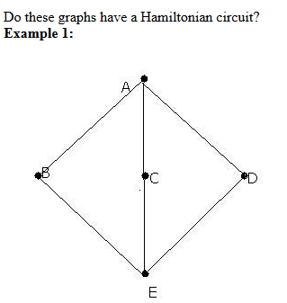
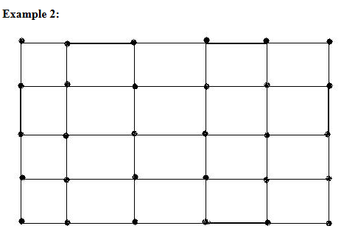
Examples
Real life applications:
- anything where you have to visit all locations, such as
pizza delivery
mail delivery
traveling salesman
garbage pickup
bus service/ limousine service
reading gas meters

Slide 9
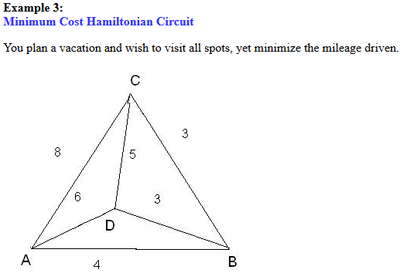
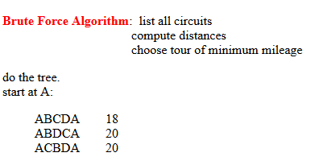
Examples

Slide 10
Sample Problem
v₁
v₂
v₃
v₄
1
state space tree
2
5
v₅
v₆
v₇
v₈
5
7
2
6
graph
6
7
3
3
4
8
:
:
3
8
4
:
:

Slide 11
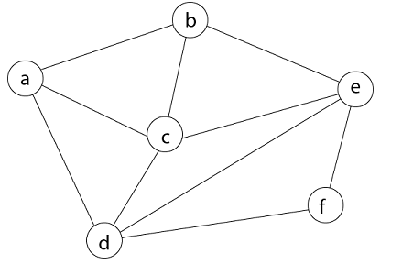
Example
Consider a graph G = (V, E) shown in fig. we have to find a Hamiltonian circuit using Backtracking method.
Firstly, we start our search with vertex 'a.' this vertex 'a' becomes the root of our implicit tree.

Slide 12

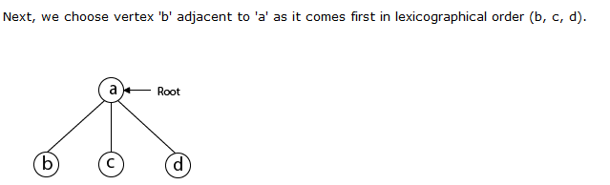
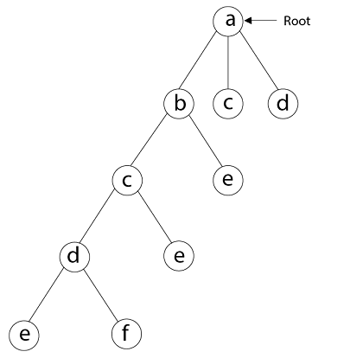
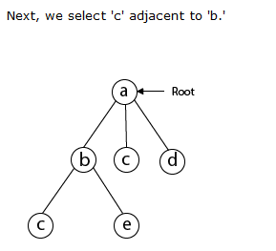
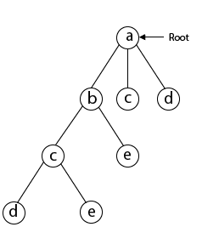

Slide 13
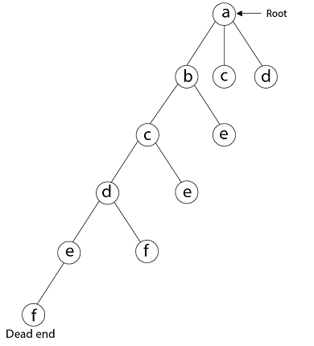
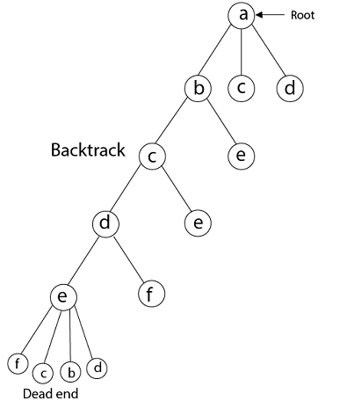
Next, we select vertex 'f' adjacent to 'e.' The vertex adjacent to 'f' is d and e, but they have already visited. Thus, we get the dead end, and we backtrack one step and remove the vertex 'f' from partial solution.
From backtracking, the vertex adjacent to 'e' is b, c, d, and f from which vertex 'f' has already been checked, and b, c, d have already visited. So, again we backtrack one step. Now, the vertex adjacent to d are e, f from which e has already been checked, and adjacent of 'f' are d and e. If 'e' vertex, revisited them we get a dead state. So again we backtrack one step.
Now, adjacent to c is 'e' and adjacent to 'e' is 'f' and adjacent to 'f' is 'd' and adjacent to 'd' is 'a.' Here, we get the Hamiltonian Cycle as all the vertex other than the start vertex 'a' is visited only once. (a - b - c - e - f -d - a).

Slide 14
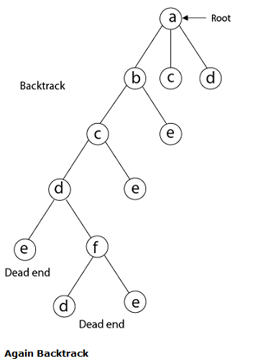
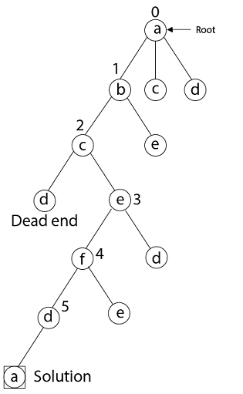
Here we have generated one Hamiltonian circuit, but another Hamiltonian circuit can also be obtained by considering another vertex.

Slide 15
Complexity
For a graph having N vertices it visits all the permutations of the vertices, i.e. N! iterations and in each of those iterations it traverses the permutation to see if adjacent vertices are connected or not i.e N iterations,
so the complexity is O( N * N! )

Slide 16
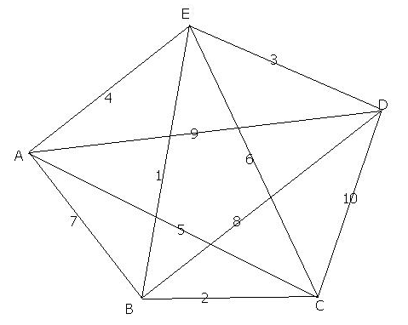
Exercise

Slide 17
Graph Coloring
Let G be a graph and m be a given positive integer.
We want to discover whether the nodes of G can be colored in such a way that no two adjacent nodes have the same color yet only m colors are used.

Slide 18
Chromatic number of the graph
If d is the degree of the given graph, then it can be colored with d+1colors
The m-colorability optimization problem asks for the smallest integer m for which the graph G can be colored.
The smallest integer m is called the chromatic number for the graph G.

Slide 19





Example
The chromatic number of the graph is: 3
b
a
e
c
d

Slide 20
4 color problem
Given any map, can the regions be colored in such a way that no two adjacent regions have the same color yet only 4 colors are needed?
For many years it was known that 5 colors are sufficient to color any map.
After several hundred years, this problem was solved by group of mathematicians.
They proved that only 4 colors sufficient to color any map.

Slide 21
Example 2
A map and its planar graph representation
1
4
5
2
2
3
1
3
5
4

